Slide 1
Recovering from a disruptive experience
information leaflet

Slide 2
Hi!
I'm glad you're interested in learning more about the recovery process.

Slide 3

Natascha Deijmann is a trained Care & Welfare Expert by Experience. She obtained her degree from the Hanze University of Applied Sciences in Groningen (the Netherlands) where she specialized in recovery from grief, loss, and bereavement.
Additionally, she is a visual artist and author of free faith-based digital products that encourage readers to work on their own recovery from a Christian perspective.
In 2026, she launched the website www.hislittleflock.com so that people can download her work for free.
Nice to meet you!

Slide 4
The recovery process

Slide 5
Phases of recovery
Gagne (2004) described the recovery process in 4 phases:
Phase 1: becoming overwhelmed
Phase 2: struggling with it
Phase 3: living with it
Phase 4: present in the background
Over the past few years, I have experienced that the recovery process is a fluid process in which you can go through the different phases time and again, while slowly working towards your own way of life in which you learn to live with the consequences of the disruptive experience(s) you have gone through.

Slide 6
Components of the recovery process
Recovering in terms of health:
  taking control and finding your own strength
Recovering your daily functioning:
  find your own balance and do what is good for you
Recovering your societal roles:
  gaining insight into your own strength, possibilities, and talents
Recovering your identity:
  searching for who you are now, what makes you happy, and what you want to change in the present and the future

Slide 7
What can promote recovery?
Therapy/treatment/ the presence and support of a committed and competent person who understands what the person in question is going through/ hope/ acceptance/ insight into triggers and pitfalls/ healthy and usable coping skills/ self-care skills/ significant others/ the courage to take risks/ satisfying work and satisfying relationships/ financial security/ intimacy/ spirituality/ sense of purpose
Kruit, 2021

Slide 8
What can hinder recovery?
Inadequate and ineffective professional help/ substance abuse/ traumatic experiences/ undignified treatment by others/ negative self-image/ lack of self-confidence/ lack of trust from significant others/ being caught off guard by triggers and pitfalls/ lack of information about healthy and useful coping strategies/ stigma/ shame
Kruit, 2021

Slide 9
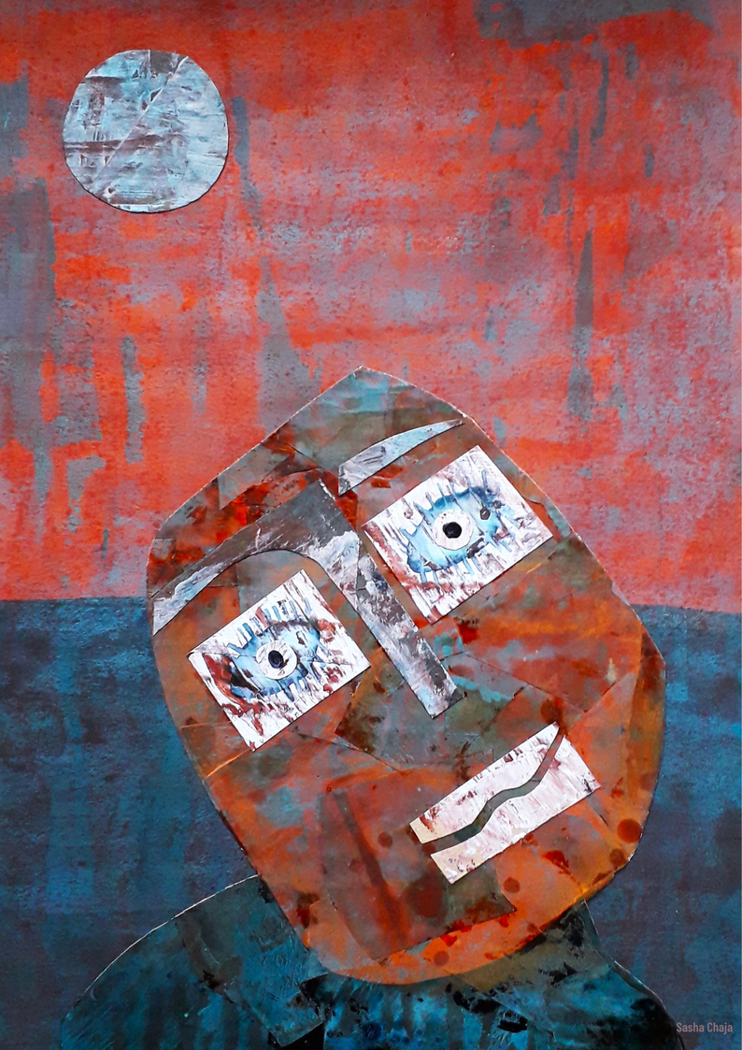
The role of art in recovery
self-expression- visual language- symbolism- finding meaning- from your head to your hands- means of communication- relaxation- physical activity- becoming visible to your surroundings- developing a new identity- using your senses- finding peace

Slide 10
Empowerment
Empowerment is the process in which you notice your strength increasing and you regain control over your own functioning. You begin to recognize your own vulnerabilities and build a new self-image. Who are you now?
It is a journey you take in search of a different, new way of life, taking into account your limitations and possibilities, so that you begin to view your life as meaningful again.

Slide 11
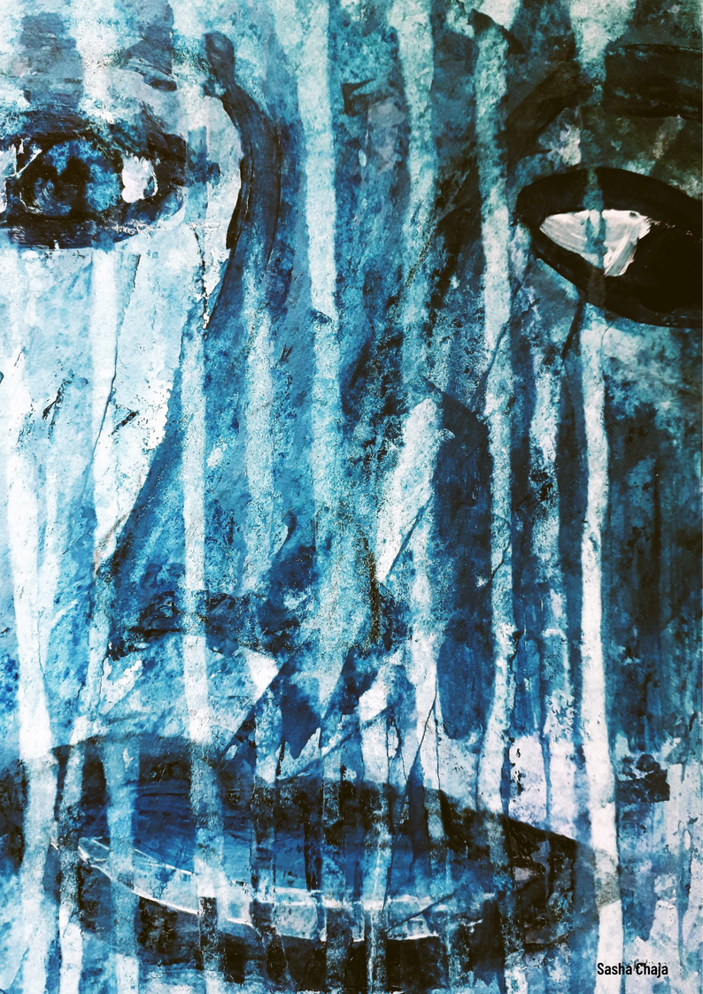
Question 1:
Which factors had an inhibiting influence on your recovery process?

Slide 12
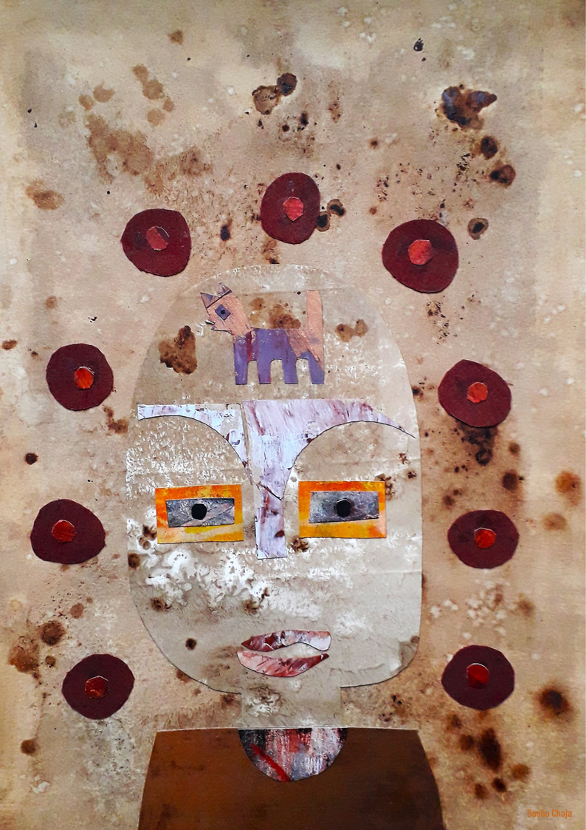
Question 2:
Which factors had a facilitating influence on your recovery process?

Slide 13
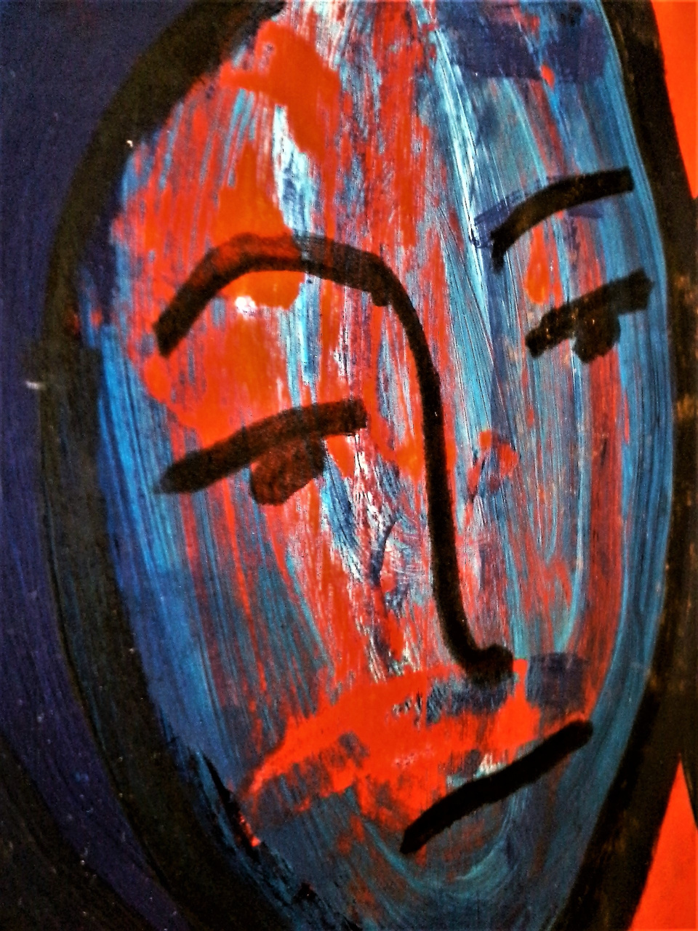
Question 3:
Do you already have insight into your triggers and pitfalls?

Slide 14
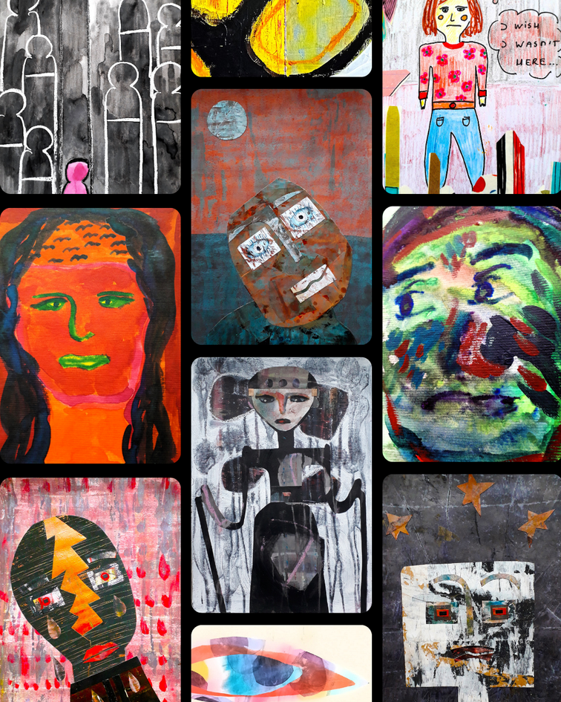
Together in recovery
You are not alone. People all over the world are in recovery. We fall and get back up. Hang in there and keep your spirits up!
God bless you,
Natascha Deijmann

